Slide 1
Chapter 1
Understanding the Basics–Object-Oriented Concepts

Slide 2
Basic Concepts of Object Oriented Analysis
Object-oriented analysis and design:
Technical approach for analyzing, designing an application/ system by applying the object oriented paradigm and visual modeling throughout the development life cycle to promote better stakeholder communication and product quality.

Slide 3
Cont…
Is the use of modeling(class,object, Actors, use case diagrams, class diagram, sequence diagram ,etc) to define and analyze the requirements necessary for success of a system.
OOAD in modern software engineering is best conducted in an iterative and incremental way.
Software Engineering is the field of study that applies the principles of engineering for software development. Software Engineer is a person who develop Software.

Slide 4
OO Concepts from a Structured Point of View
Objects and Classes
The OO paradigm is based on building systems from items called objects
An object is any person, place, thing, event, concept, screen, or report. It is an instance of a class.
A class generalizes/represents a collection of similar objects and is effectively a template from which objects are created.
E.g. In a banking system Daniel is a customer object and customer is a class.

Slide 5
Cont…
Modeling a class: either a rectangle that lists its attributes and methods or as just a rectangle
The first method enables reader to gain better understanding of the class or can confuse your diagrams and unclear readability.

Slide 6
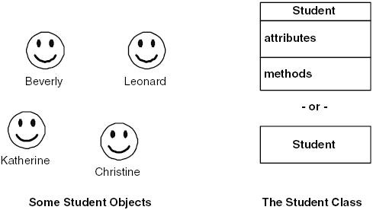
Class names: should be one or two words, usually a noun, and should accurately describe the class like Student, person, customer, Book, Course, etc.
Class can also represent concepts that are not nouns, like the process of checking out a book from a library.

Slide 7
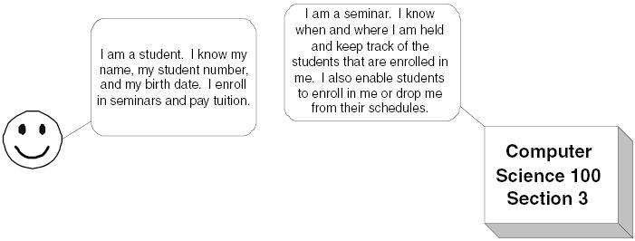
Attributes and Operations/Methods
objects have both data and functionality. Attributes define the data, while methods define the functionality.
Definition of an attribute: Name and type
Definition of method : define the logic , just as you would code for a function or a procedure. Method s either return a value or do something of a value.

Slide 8
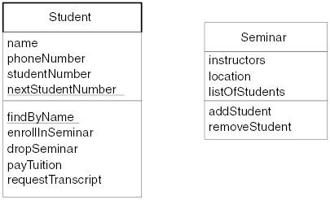
Attributes can be:
Instance attribute: are applicable to a single object. For example, name is an instance attribute of the class Student. Each individual student has a name
Static attribute: are applicable to all instances of a single class.
Static attributes are underlined, instance attributes are not.

Slide 9
Abstraction
is a method of collecting relevant information (possible attributes, methods, responsibilities) from the given problem domain.
Is an analysis issue that deals with what a class knows or does.
Abstraction of a person from point of view of a university
it needs to know the person's name, address, telephone number, social security number, and educational background
Abstraction of a person from point of view of a police
they need to know a person's name, address, phone number, weight, height, hair color, eye color, and so on
Encapsulation
is a design issue that deals with how functionality is grouped within a system.
In the object-oriented world, systems are modularized into classes, which, in turn, are modularized into methods and attributes. We say that we encapsulate behavior into a class or we encapsulate functionality into a method.

Slide 10
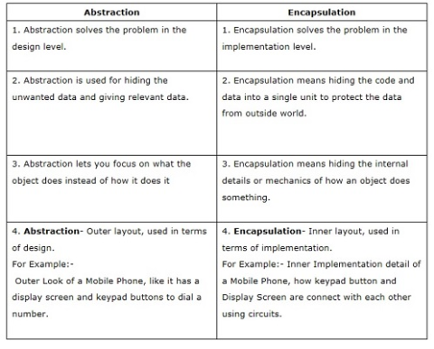

Slide 11
Information Hiding
It is just restricting access to properties of a class by another class. Attributes of a class should be accessed by another class if and only if they have given permission.
prevent other programmers from writing highly coupled code (a change in one part of the code forces you to make a change in another)
Inheritance
Inheritance is a technique for creating a new class (subclass) from an existing class (super class) by adding more functionality to it.
A subclass is derived from a super class. Example: An Employee is a Person.
The subclass inherits the attributes and behavior of the superclass.
The subclass can override the behavior of the superclass.
Inheritance supports code re-use.
Inheritance Tips and Techniques
The following tips and techniques should help you to apply inheritance effectively.

Slide 12
Look for similarities: go for inheritance whenever you have similarities between or among two or more classes, either similar attributes or similar methods
Look for existing classes: When you identify a new class, you might already have an existing class to which it is similar. E.g. The Person class already has many of the features an Administrator class needs
Follow the sentence rule. One of the following sentences should make sense: "A subclass is a kind of superclass" or "A subclass is like a superclass." For example, it makes sense to say a student is a kind of person and a dragon is like a bird.
Inherit everything. The subclass should inherit everything from the super- class, a concept called pure inheritance. If it does not, the code becomes harder to understand and maintain.

Slide 13
Single and Multiple Inheritance
single inheritance: when a class inherits from only one other class
multiple inheritance : When a class inherits from two or more other classes. Supported by C++ etc
Relationships
Is an association between two or more objects
Help us to define how objects interact with each other
For example, students take courses, professors teach courses, criminals rob banks, and driver drive cars. Association is defined by verbs such as take, teach, rob, drive etc.
Relationships are identified but must be also be described:
How many seminars can students take? None, one, or several?
relationships are two-way streets: not only do students take seminars, but also seminars are taken by students. This leads to questions like how many students can be enrolled in any given seminar?

Slide 14
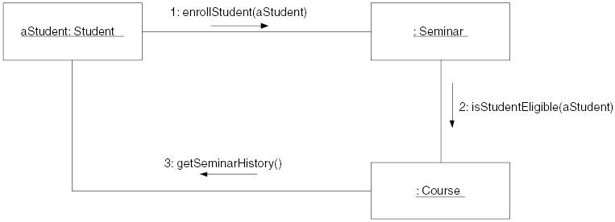
Collaboration
Objects collaborate with one another by sending each other message.
A message is either a request to do something or a request for information.
Messages are modeled using UML sequence diagrams and communication diagrams (Collaboration Diagram)

Slide 15
The boxes across the top of the diagram represent classifiers, in this case objects.
The dashed lines hanging from them are called lifelines, which represent the life span of the object during the scenario being modeled.
Objects have labels in the format name: class where name is optional (objects that have not been given a name on the diagram are called anonymous objects).
The instance of Student was given a name because it is used as a parameter in a message
Messages are indicated as labeled arrows, the label being the signature of the method.
Return values are optionally indicated using a dashed arrow with a label indicating the return value.

Slide 16
Interfaces
An interface is the definition of a collection of one or more methods, and zero or more attributes.
Interfaces are implemented by classes and components.
To implement an interface, a class or component must include the methods defined by the interface.
Patterns
A pattern is a solution to a common problem taking relevant forces into account, effectively supporting the reuse of proven techniques and approaches of other developers.
Analysis patterns describe a solution to common problems found in the analysis/business domain of an application
Design patterns describe a solution to common problems found in the design of systems
Process patterns address software process- related issues.

